Slide 1

DATABASE MGMT PROJECT

Slide 2
NETFLIX
Netflix has a global subscriber base of over 200 million people who watch movies and TV shows online. Customers can watch as many shows as they like as long as they have an internet connection and a monthly subscription that starts at $10. It also creates original material and licenses feature films and television shows for streaming.

Slide 3
Numbers! Because Numbers are business
Launched 24 years ago.
Over 200 Million Subscribers.
Multiple Devices supported.
125+ Million hours watched daily.

Slide 4
Data Numbers!
800+ Billion events written.
50 petabyte data warehouse.
4 petabyte DW reads.
300 terabyte DW writes.

Slide 5
Services Netflix Provide?
Award winning Movies/TV shows (Obviously)
Unlimited high quality video streaming.
Personalized(User) Recommendations.
Film Production, On Demand Video Plans etc..

Slide 6
Back to Subject, BUSINESS RULES
Netflix is primarily driven by two factors: USERS and CONTENT.
Content is classified into
Movies
TV Shows/Series
Content can either be a Movie or TV show but not both.
To view the content, the customer must purchase a subscription.

Slide 7
Each content has a ContentID that uniquely identifies it, as well as the title, release date, genre, IMDB ratings, and director/producer name. The number of seasons of a TV show is an attribute for TV show, while the duration of a film is an attribute for Movies.
CustomerID is a unique identifier that is used to identify each customer. Name, Address, Email, and Phone Number are some of the other properties.
SubscriptionID is a unique identifier that is used to identify the subscription, other attributes being subscription type, Price, subscription & Expiry Date.

Slide 8
This platform has a unique feature known as Xray. It includes information about the actors and actresses who appeared in the film, as well as information about the film itself, including any accolades received.
This Platform will establish a profile for a player (actor or actress) who is in the film. Each player is assigned a unique profileID, as well as their name, birth date, birthplace, and the name of the character they played in the movies.
Xray also shows whether the movie or the character has received any awards. The award contains the name of the award and the year in which it was given out. If it is given for a movie, it contains the title of the film; if it is given for a player, it contains the name of the player.

Slide 9
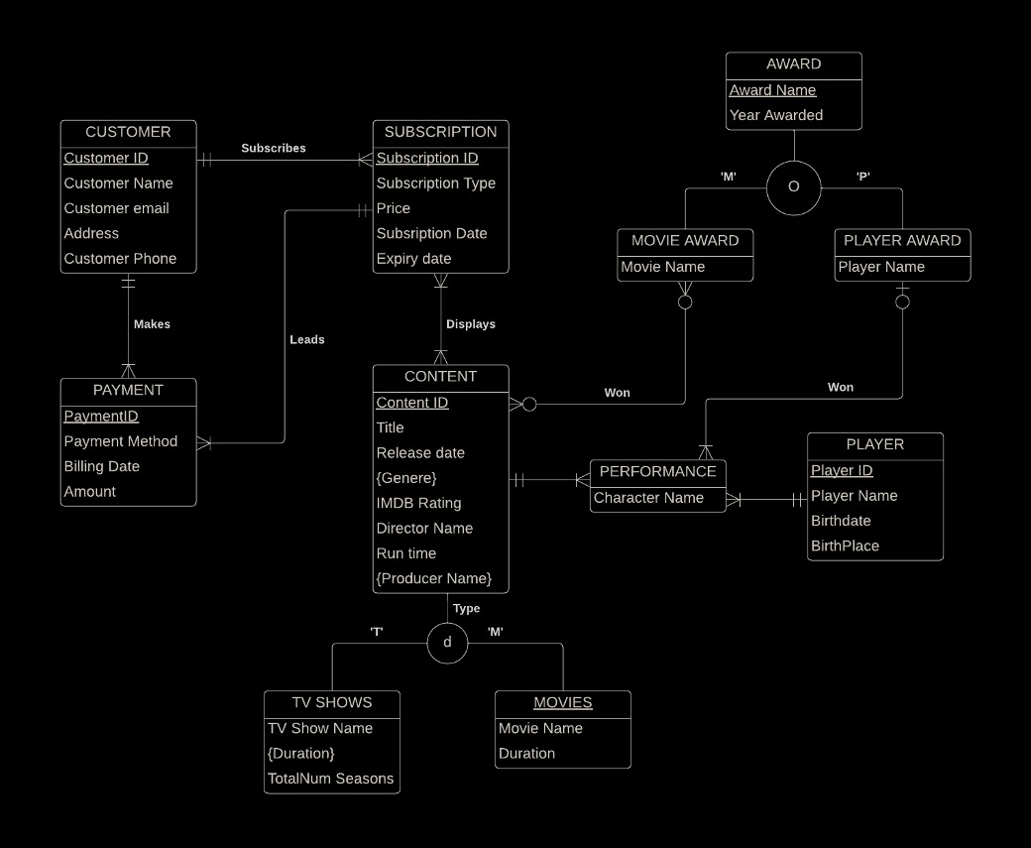
Entity-Relationship Diagram

Slide 10
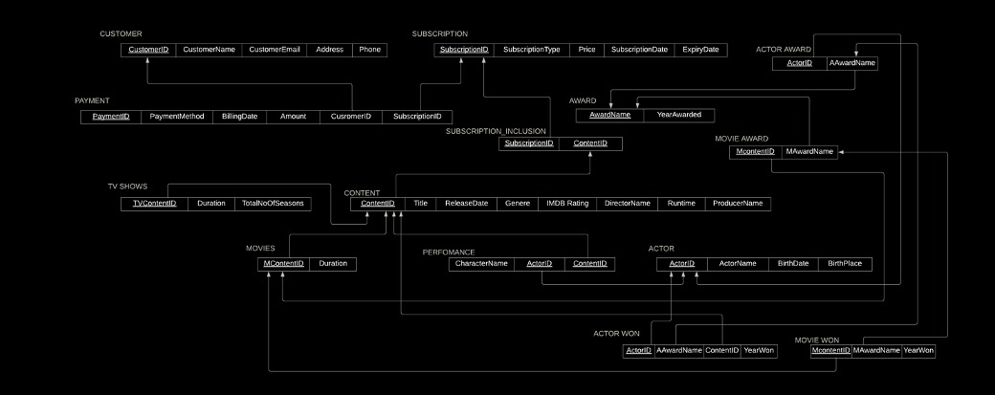
Relational Model

Slide 11
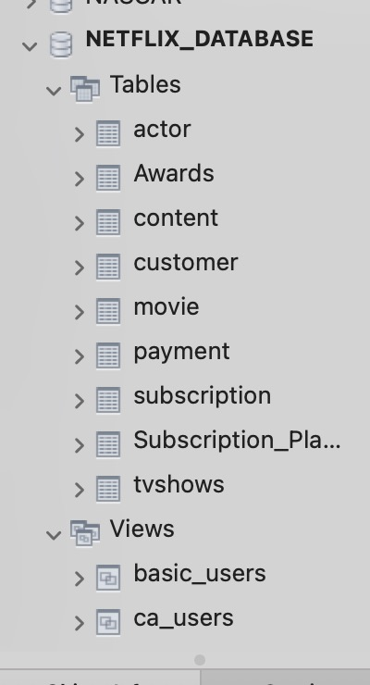
Tables

Slide 12
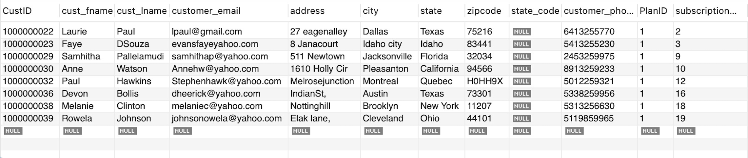
Subquery
select * from customer where subscription_id in (select subscription_id from subscription where subscription type='Basic'):

Slide 13
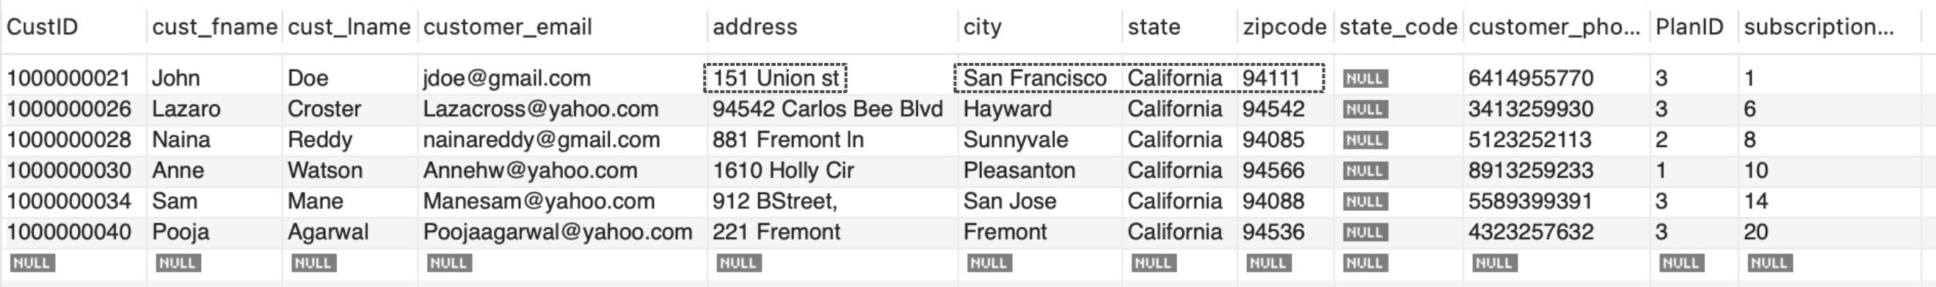
Subscribers from California in Customer Table
select * from customer where state='California';

Slide 14
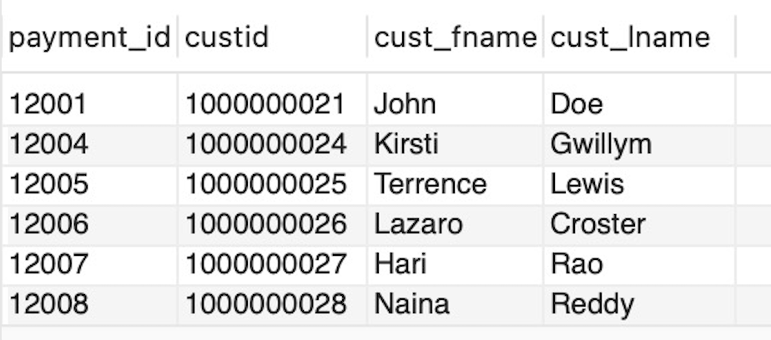
Inner Join
SELECT payment.payment_id, payment.custid, customer.cust_fname, customer.cust_lname
FROM payment
INNER JOIN Customer ON payment.custid=customer.custid where payment.amount>'10' ;

Slide 15
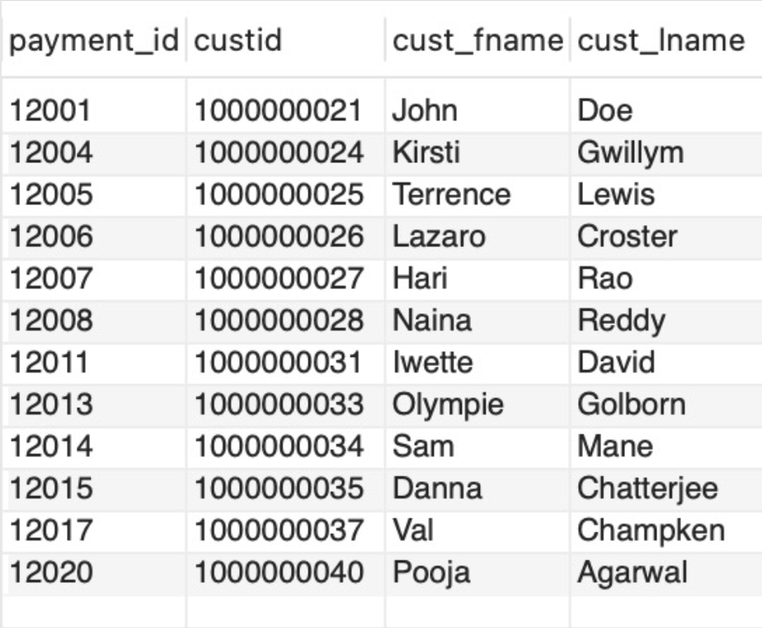
Left Join
SELECT payment.payment_id, payment. custid, customer.cust_fname, customer.cust_lname
FROM payment
LEFT JOIN Customer ON payment. custid=customer. custid where payment.amount>'10' ;

Slide 16
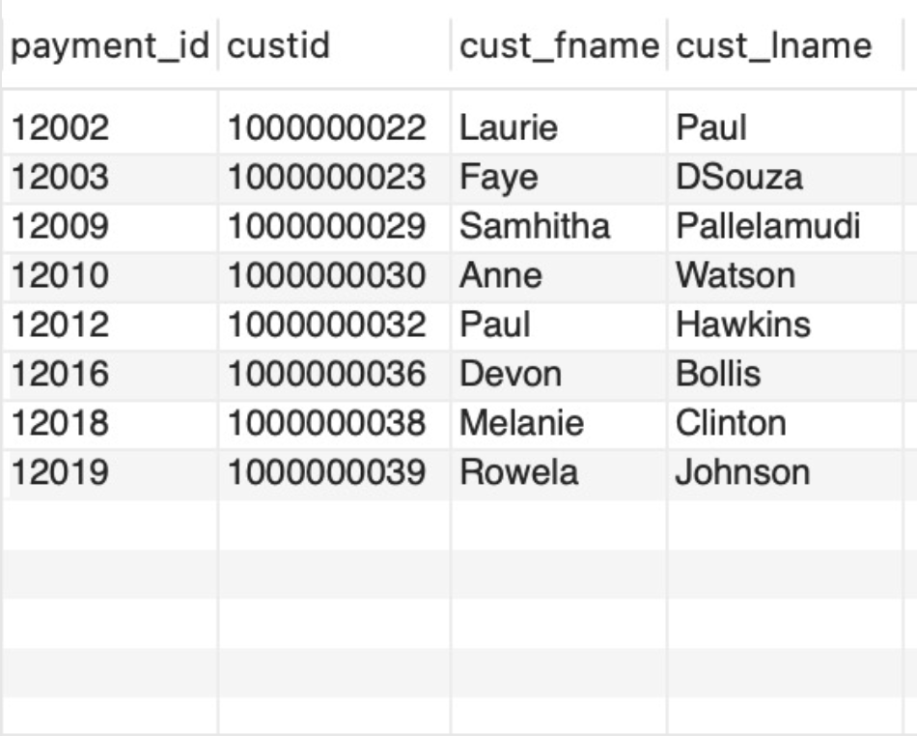
Right Join
SELECT payment.payment_id, payment.custid, customer.cust_fname, customer.cust_lname
FROM payment
RIGHT JOIN Customer ON payment.custid=customer. custid where payment.amount<'10' ;

Slide 17
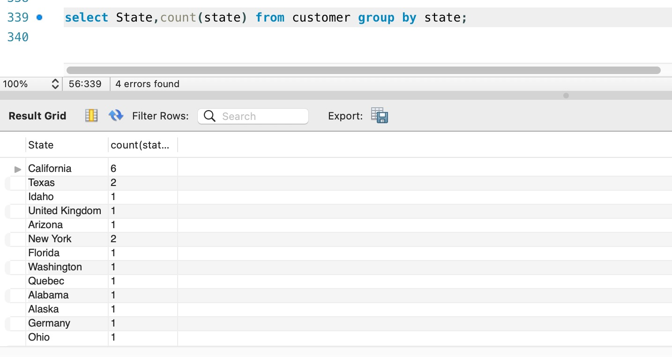
Group By
select State, count (state) from customer group by state;

Slide 18
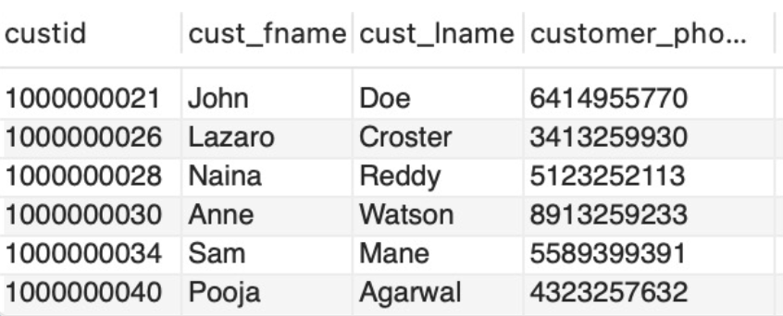
View (California Users)
create view CA_users as select custid, cust_fame, cust_lame, customer_phone from customer where state='California’;
select * from ca_users:

Slide 19
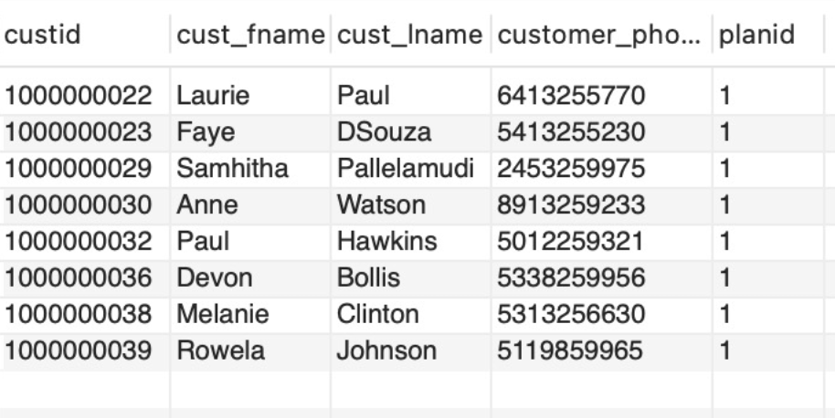
View (Basic Users)
create view Basic_users as select custid, cust_fame, cust_lname, customer_phone, planid from customer where planid='1';
select * from Basic_users;

Slide 20
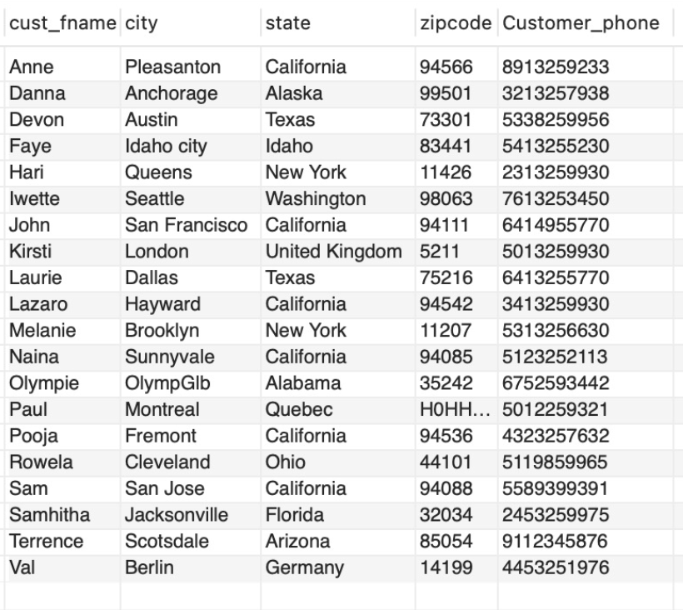
Stored Procedure
CREATE PROCEDURE Customers()
BEGIN
SELECT cust_fname, city, state, zipcode, Customer_phone
FROM customer
ORDER BY cust_fname;
END$$
DELIMITER ;
call Customers;

Slide 21
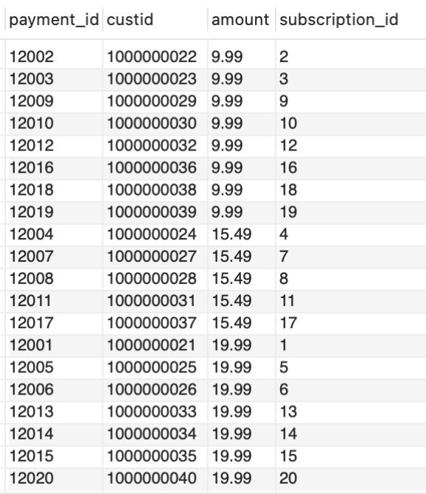
Stored Procedure
CREATE PROCEDURE paymentdetails()
BEGIN
SELECT payment_id, custid, amount, subscription_id
FROM cpayment
ORDER BY amount asc;
END$$
DELIMITER ;
call paymentdetails;

Slide 22
Questions?

